Slide 1
運用人工智慧計算血液透析病人血管鈣化程度並建置血管預後的預測模型
計畫主持人 : 馬清文 教授
共同計畫主持人: 林佳勳 主任

Slide 2
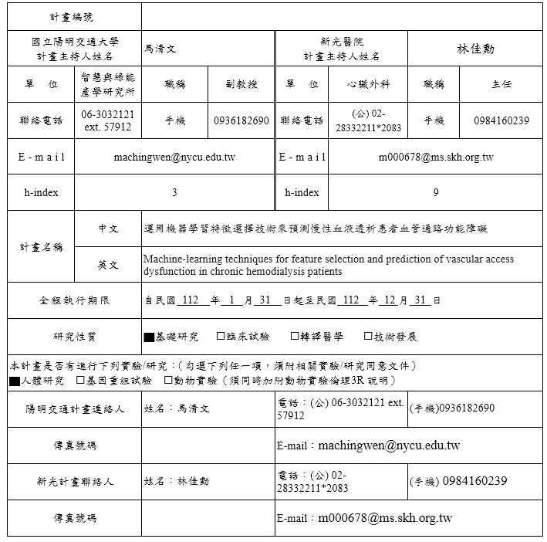

Slide 3
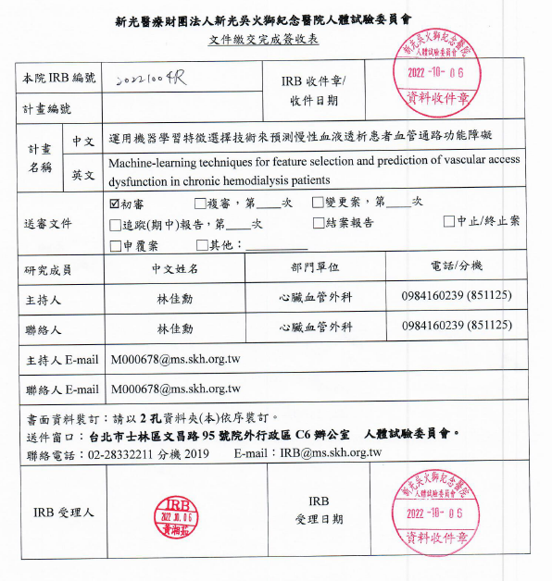

Slide 4
IRB委員意見1
初審申請表有勾選對照組，請說明
主持人回覆：此研究是要決定流量的閥值，仍需機器學習後，再根據閥值的值，進行分組，符合閥值與未符合閥值兩組，最為未來的對照，先要決定一個cut off point再去分組，此對照組為未符合閥值與組別。

Slide 5
IRB委員意見2
申請表列為雙組平行，但計畫書看似並無對照組，請確認
為病歷回溯，但申請書卻勾選前瞻性，請確認
為病歷回溯之研究，但納入排除條件之陳述應調整為符合該情境之病歷資料，如[排除條件： 不能配合相關檢測的病患]是否調整為[無OOO檢測資料之病歷]
請說明樣本數計算依據
預計使用機器學習進行分析，但主持人未見相關人員及資料
請說明資料存放位置即可使用者之管控。

Slide 6
委員意見2
用機器學習進行閥值，再根據閥值去做分組。
感謝委員提醒，已更改勾選回顧性，並附件上呈。
謝謝委員提點，將根據委員的意見更改為，無血管通路檢測資料之病歷。
依據目前臨床實際病人情況估算，每年規則於新光醫院聖賢透析室透析的患者約450人次，每年死亡約10%，但新進透析病人會補上此缺額，故以2017年算起至2021年，共計450+45*4=630，預估為600多人。
計劃案過程與國立陽明交通大學，智慧與綠能產學研究所，馬清文教授做媒合，他將以豐富的機器學習經驗協助此案，由於他目前仍然在完善IRB時數，之後會將該主持人相關信息補足上呈。
資料存放於主持人有設置密碼的個人電腦，僅供主持人與相關研究人員審閱。

Slide 7
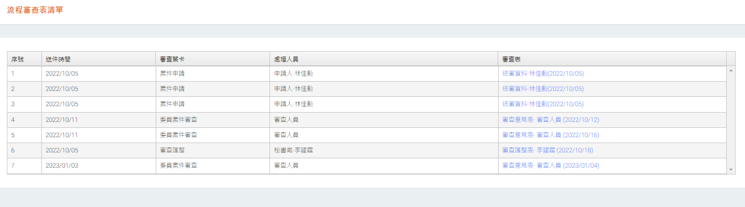
複審中

Slide 8
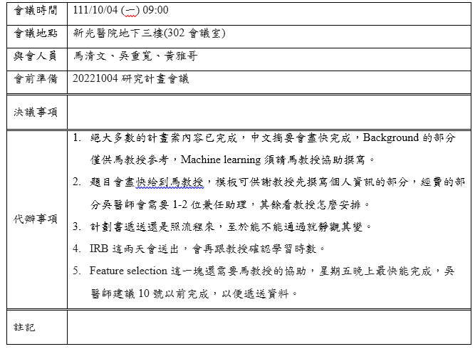
會議紀錄

Slide 9
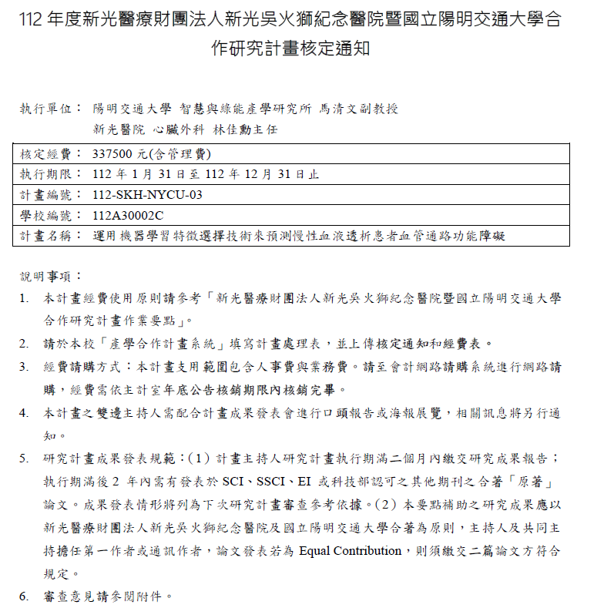
經費規劃
新光端
兼任碩士級助理1名
陽交端
兼任碩士級助理兩名
待看馬教授的需求

Slide 10
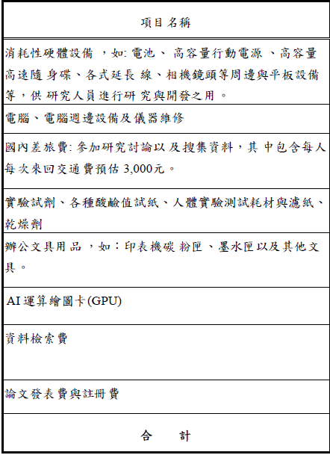
耗材、物品及雜項費用

Slide 11
Introduction
Vascular access dysfunction is a leading cause of dialysis-related morbidity and regular vascular access monitoring and surveillance is recommended to improve patency and decrease complications. Regular physical examination of vascular access is carried out to monitor for and detect the vascular access dysfunction and periodic measurements of venous pressure and vascular access blood flow (Qa) have been used as means of access surveillance.

Slide 12
Introduction
However, critical Qa threshold possibly varies from persons to persons. Many factors can influence Qa and optimal value may vary for each patient. This study will employ machine learning algorithm to find the factors affecting the Qa and determine critical flow threshold for more precise vascular access surveillance.

Slide 13
Objective
The work aims to identify the factors that affect vascular access blood flow (Qa) and to determine an individuated critical flow threshold in chronic hemodialysis patients. A machine learning algorithm for more precise vascular access surveillance will be designed to build up the best prediction model for determination of vascular access intervention in chronic hemodialysis patients.

Slide 14
Methods
Adult patients who received chronic hemodialysis dialysis via functional arteriovenous access at the hemodialysis unit of Shin Kong Wu Ho-Su Memorial Hospital between January 1, 2017 and December 31, 2021 were enrolled in this observational study. The vascular access surveillance was performed every three months. The study period was from the date of vascular access flow measurement (Qa) till the occurrence of vascular access outcomes or the end of the study on December 31, 2021.

Slide 15
Methods
Patients lost to follow-up, transferred to different dialysis clinics, or had a kidney transplant were excluded. Multiple comparisons among the different groups were performed using the independent student t-test or Mann-Whitney U test for continuous variables or the Pearson chi-squared test or Fisher’s exact test for categorical variables. Univariate and multivariate logistic regression analyses were performed to find the factors affecting Qa. Machine learning model will be developed to accurately determine critical flow threshold and determine the intervention of vascular access.

Slide 16
Methods
An advanced machine learning system that can calculate a more precise critical flow threshold for individual patients will be developed in the future. In hemodialysis patients, this individual Qa threshold could be a valuable marker for predicting unfavorable vascular access outcomes, mortality, CV mortality, and major adverse CV events. This information can provide clinicians with a chance to intervene early and reduce the occurrence of unfavorable vascular access outcomes, mortality, CV mortality, and major adverse CV events

Slide 17
Anticipated results
Machine learning algorithm can accurately find the factors affecting the vascular access flow and determine critical flow threshold in chronic hemodialysis patients.

Slide 18
Key words
vascular access flow, machine learning, prediction model, feature selection.

Slide 19
What is New or Innovative in this Study?
An advanced machine learning system that can calculate a more precise critical flow threshold for individual patients will be developed in the future. In hemodialysis patients, this individual Qa threshold could be a valuable marker for predicting unfavorable vascular access outcomes, mortality, CV mortality, and major adverse CV events. This information can provide clinicians with a chance to intervene early and reduce the occurrence of unfavorable vascular access outcomes, mortality, CV mortality, and major adverse CV events.

Slide 20
血管通路流速月檢測報表20230105095322

Slide 21
血管通路流速月檢測報表20230105095322

Slide 22
血管通路流速月檢測報表20230105095322

Slide 23
周邊血管手術申報表總整理_104_109年度

Slide 24
Final database 2018_2021_最終資料庫優化_VHD_VC

Slide 25
Final database 2018_2021_最終資料庫優化_VHD_VC

Slide 26
Final database 2018_2021_最終資料庫優化_VHD_VC

Slide 27
Final database 2018_2021_最終資料庫優化_VHD_VC

Slide 28
Final database 2018_2021_最終資料庫優化_VHD_VC

Slide 29
Final database 2018_2021_最終資料庫優化_VHD_VC

Slide 30
Final database 2018_2021_最終資料庫優化_VHD_VC

Slide 31
Final database 2018_2021_最終資料庫優化_VHD_VC

Slide 32
Final database 2018_2021_最終資料庫優化_VHD_VC

Slide 33
Final database 2018_2021_最終資料庫優化_VHD_VC

Slide 34
Final database 2018_2021_最終資料庫優化_VHD_VC

Slide 35
Final database 2018_2021_最終資料庫優化_VHD_VC

Slide 36
Final database 2018_2021_最終資料庫優化_VHD_VC

Slide 37
Final database 2018_2021_最終資料庫優化_VHD_VC

Slide 38
Final database 2018_2021_最終資料庫優化_VHD_VC

Slide 39
Final database 2018_2021_最終資料庫優化_VHD_VC

Slide 40
Final database 2018_2021_最終資料庫優化_VHD_VC

Slide 41
Final database 2018_2021_最終資料庫優化_VHD_VC

Slide 42
Final database 2018_2021_最終資料庫優化_VHD_VC

Slide 43
Final database 2018_2021_最終資料庫優化_VHD_VC

Slide 44
Final database 2018_2021_最終資料庫優化_VHD_VC

Slide 45
Final database 2018_2021_最終資料庫優化_VHD_VC

Slide 46
Final database 2018_2021_最終資料庫優化_VHD_VC

Slide 47
Background
Hemodialysis (HD) is the most widely used renal replacement therapy worldwide. Arteriovenous fistula (AVF) or graft (AVG) and central venous catheters (CVC) are currently the most commonly used vascular access in HD patients. A functional vascular access is necessary for achieving dialysis efficacy. Vascular access dysfunction is a leading cause of dialysis-related morbidity and is responsible for approximately a quarter of hospitalization in hemodialysis patients.

Slide 48
Background
Stenosis and thrombosis are the most common causes of vascular dysfunction. Late detection of access dysfunction is associated with increased morbidity and mortality, prompting the pre-emptive detection and timely correction of access dysfunction. Current guidelines recommend regular vascular access monitoring and surveillance to improve patency and outcome.

Slide 49
Background
Regular physical examination of vascular access is carried out to monitor for and detect the flow dysfunction. Periodic measurements of venous pressure and access blood flow (Qa) have been used as means of access surveillance to detect stenosis or thrombosis early. Qa threshold varies from guidelines to guidelines. The Kidney Disease Outcomes Quality Initiative (KDOQI) guidelines for vascular access in 2006 endorsed intra-access flow (Qa) measurement as the primary vascular access surveillance method.

Slide 50
Background
It indicated the access flow rate of <500 ml/min in AVF, <600 ml/min in AVG, or access flow rate decline 25% in 3 to 6 months as optimal threshold. The updated 2019 KDOQI guideline recommended regular physical examination by experienced physician as primary mean of monitoring access dysfunction aided by Qa surveillance. However, the Renal Association Clinical Practice Guidelines recommended Qa threshold of <300ml/min for AVF as an indication for investigation.

Slide 51
Background
Regarding the optimal Qa threshold, many factors can influence Qa, including systemic hemodynamics, the size and endothelial function of the vessels supplying and draining the access, the existence of substantial vascular stenosis, and patient characteristic such as age, weight, diabetes status, blood pressure and access location.

Slide 52
Background
Optimal Qa value may vary for each individual patients and using a set threshold form guidelines might sometimes miss the early detection of vascular dysfunction. This study aims to find the factors affecting the Qa to determine critical flow threshold in HD patients and develop machine learning algorithm for more precise vascular access surveillance. Secondly, we aim to determine the best prediction model that determine the requirement of vascular access intervention in HD patients.

Slide 53
Study population
Adult patients who received chronic hemodialysis dialysis via functional arteriovenous access at Shin Kong Wu Ho-Su Memorial Hospital's HD dialysis unit between January 1, 2017 and December 31, 2021 were enrolled for this observational cohort research. The study lasted from the date of access flow measurement (Qa) until the occurrence of outcomes or the end of 2021. Patients lost to follow-up, transferred to different dialysis clinics, or had a kidney transplant were not included. Patients with critical access flow were divided into two groups based on the presence or absence of symptoms and signs of vascular access dysfunction

Slide 54
History collection and laboratory data
Demographic and baseline clinical data were obtained from the patients’ medical records during the entry in the study; the data included age; sex; comorbid disease history; blood pressure; end-stage renal disease (ESRD) causes; vascular access type; vascular access flow (Qa); dialysis vintage; erythropoiesis-stimulating agent (ESA) dosage; lipid and iron profiles; hemoglobin, serum albumin, intact parathyroid hormone (iPTH), sodium, potassium, ionized calcium, and phosphate levels; and HD efficiency (Kt/V). Before each dialysis session, blood samples were obtained after fasting for at least 8 hours. Kt/V was calculated using the method described by Gotch et al

Slide 55
Deep learning for addition features
A. Types of the time-series blood flow measurements
In addition to the Qa threshold, the type of time series blood flow measurement may also be important to this research. There are different categories of these types, for example, some are stable and some are not

Slide 56
Deep learning for addition features
B. Labeling of the time series blood flow measurements
According to clinical experience, a certain amount of the time series blood flow measurements will be labeled by doctors. These labels can be used in two ways: one to help machine learning methods mentioned in the previous paragraphs; the other is to build a deep learning AI system that automatically recognizes the types of the time series blood flow measurements.

Slide 57
Deep learning for addition features
C. Deep learning AI system with uncertainty calibrated
When automatically classifying the types of the time serial blood flow measurements, we require the AI system to indicate a calibrated uncertainty, which means the AI system will not be over-confident on its prediction. To achieve this goal, we will use deep kernel learning. It consists of a deep neural network for feature extraction and a Gaussian Process kernel for classification. The block diagram is shown below: The output of the GP kernel is the probability distribution of its prediction.

Slide 58
Deep learning for addition features
C. Deep learning AI system with uncertainty calibrated
Therefore, overconfidence is avoided. In addition, this model can be trained in an end-to-end manner, which means if the dataset is large and has a wide coverage, good generalization capability can be achieved without human intervention. For those that are not covered by the dataset, the prediction confidence will be low.

Slide 59
Deep learning for addition features
C. Deep learning AI system with uncertainty calibrated
The output of the GP kernel are the probability distribution of its prediction. Therefore overconfidence is avoided. In addition, this model can be trained in an end-to-end manner, which means if the dataset is large and has a wide coverage, good generalization capability can be achieved without human intervention. For those that are not covered by the dataset, the prediction confidence will be low

Slide 60
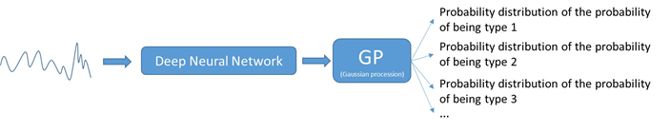
Deep learning for addition features
C. Deep learning AI system with uncertainty calibrated

